Slide 1
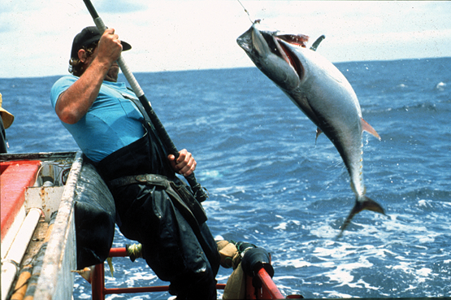
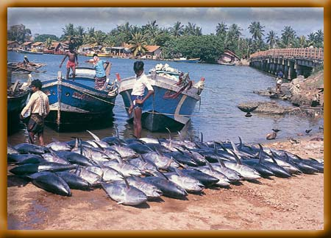

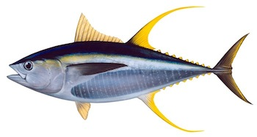
IOTC-2021-WPM12(MSE)-03 IOTC Yellowfin Management Strategy Evaluation: March 2021 Update Dale Kolody Paavo Jumppanen CSIRO Oceans & Atmosphere, Australia

Slide 2
Outline
Software and documentation available from:
https://github.com/pjumppanen/niMSE-IO-BET-YFT/
Current status of reference set OM
Issues encountered in last iteration
What plausibility diagnostics should we be using?
Workplan proposal

Slide 3
Context
Aiming for an inclusive effort across the IOTC scientific community, highly dependent on the relevant experts
Draft YFT MP resolution circulated to 2019 TCMP & Commission (under further development)
OM reconditioning – when is it required?
takes a lot of time away from other tasks (e.g. MP development)
Want to avoid being stuck in an endless loop (Butterworth’s “guillotine”)
But don’t want to proceed prematurely either
YFT/BET MSE support funding ends July 2021 – Australian government expressed interest in extending for 12 months

Slide 4
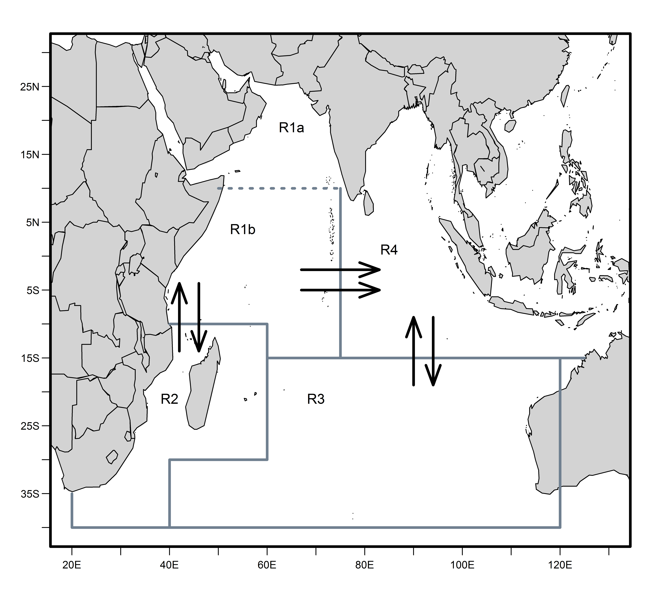
YFT (2018) assessment + recent developments
Fu et al. (2018)
Urtizberea et al (2020)
Stock Synthesis (Methot and Wetzel 2013)
4 Areas Quarterly dynamics 1952-2017
25 fisheries (21 + time changes)
Age-structured
Spatial BH Recruitment
Emphasis on MPD (best) estimates
Key differences between assessment and OM conditioning assumptions:
Environmental indices not used for OM migration (e.g. hard to project)
Recruitment constrained to stock-recruit relationship for recent 12 quarters
OM initial N = Assessment final N + age-dependent error
Uncertainty “grid” ensemble with 7 dimensions in OM

Slide 5
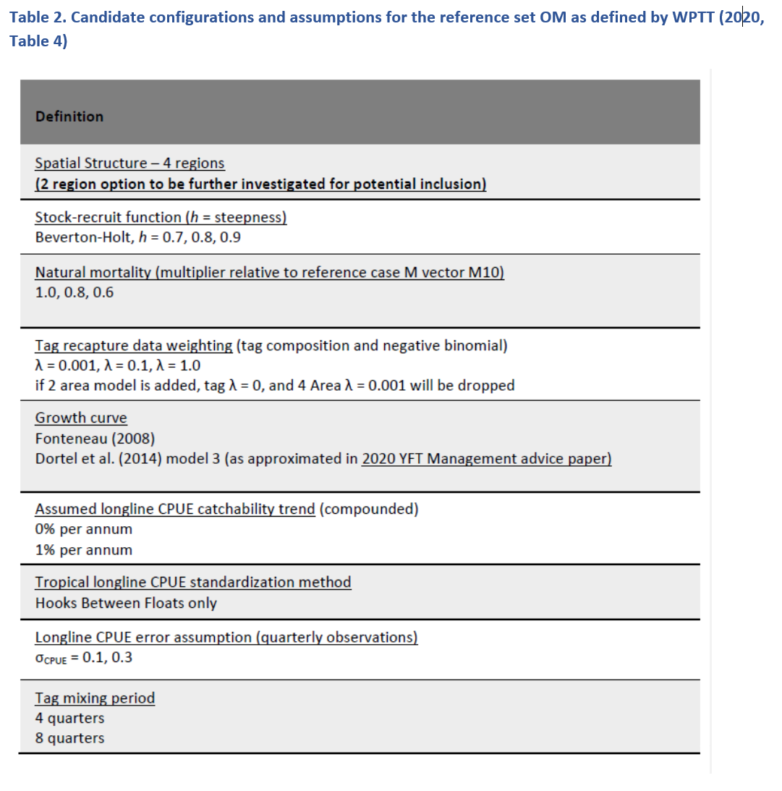
WPTT/WPM 2020 Yellowfin OM Requests
2 Area for further investigation

Slide 6
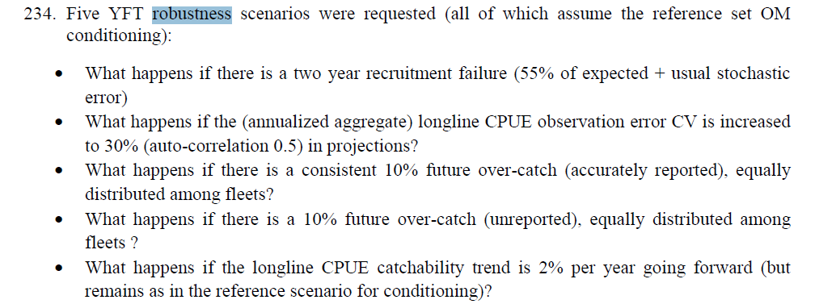
Robustness tests
6. New: What happens if there is a 10% overcatch, half reported, half not reported?

Slide 7
Spatial Structure for OM?
Substantial MSE code changes would be required to pool spatial structures within an OM
2 area structure implications
More parsimonious
less over-parameterized
more numerically stable
Perhaps less sensitive to movement errors
With no movement, why accept a quota cut if the depletion problem is in a separate population?
If tags excluded from 2 area models, tags only given full weight in 17% of grid
Pooling of heterogenous tropical and temperate regions for CPE purposes
Urtizberea et al 2020 – diagnostics suggested that 83% of “retained” models were 4 area configuration

Slide 8
Add the 2 area option?
Are the 2 area vs 4 area inferences actually different?
If so, why?
Spatial structure per se?
Restricted Movement?
Removal of tags?
Seemingly most important

Slide 9
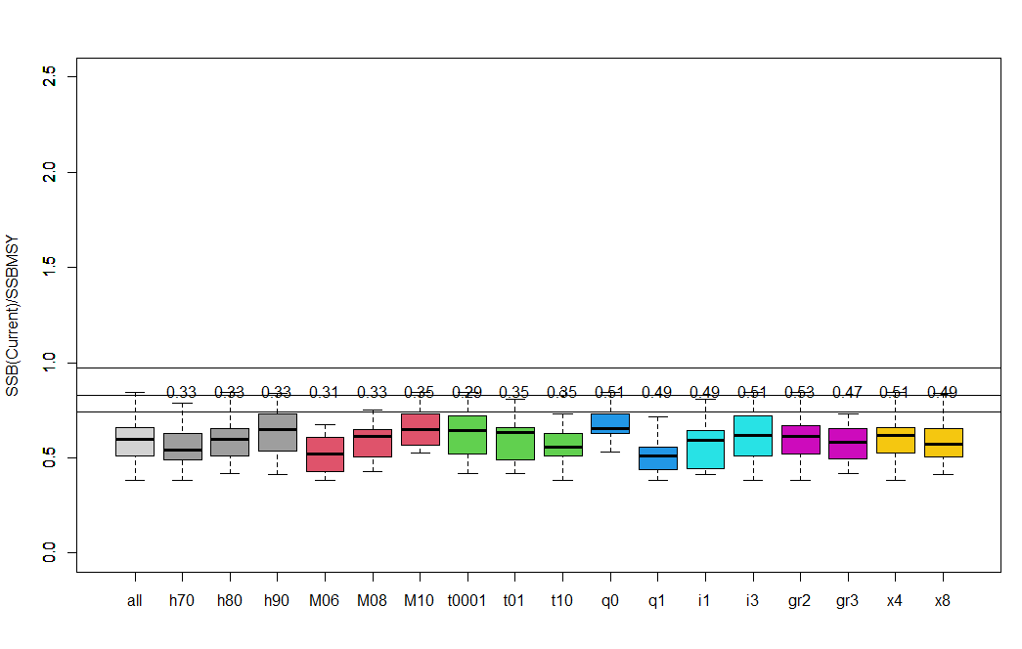
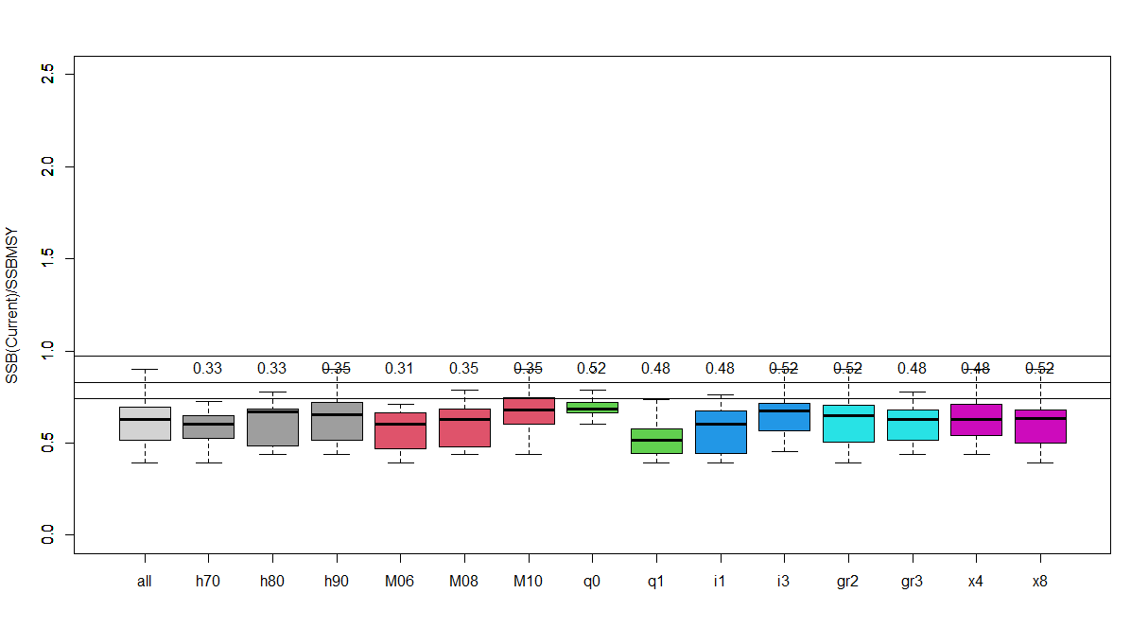
Pessimistic OM assumptions not in stock assessment LL Q trend CPUE CV = 10%
4 Area Reference Set OM B(2017)/B(MSY)
(52 converged model ensemble)
tags
Fu et al (2018) assessment
2 Area Reference Set OM B(2017)/B(MSY)
(54 converged model ensemble)
ENV-link movement?

Slide 10
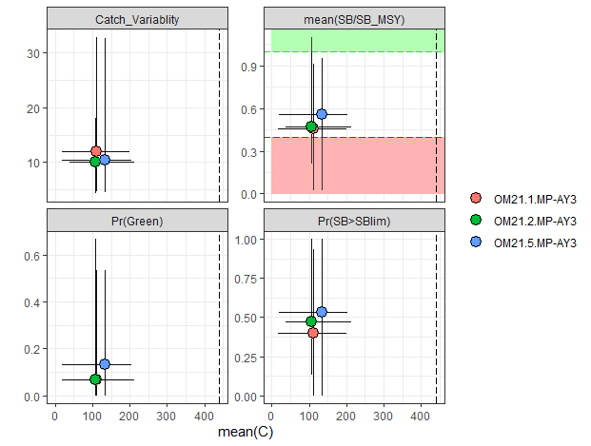
Does the spatial structure matter for MP evaluation results?
PTRE projection-based MP
Tuned to intermediate OM
Seemingly not so much
4 Area Reference set OM
2 Area Reference set OM
4 Area Reference set with no tags

Slide 11
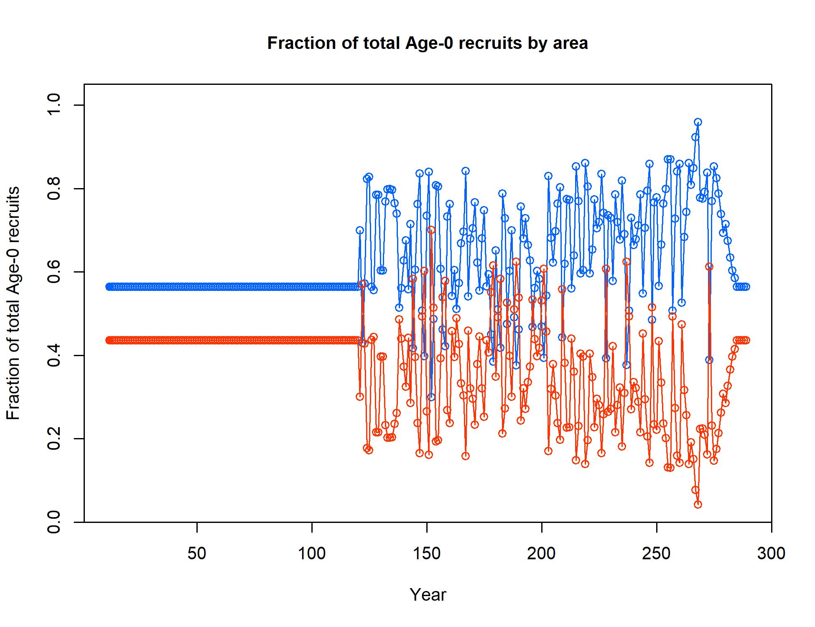
What about the trend in recruitment spatial deviations – does it matter for MP evaluation?
2 Time Blocks
1 Time Block

Slide 12

What about the trend in recruitment spatial deviations – does it matter for MP evaluation?
4 Areas – 1 Time block
4 Areas – 2 Time blocks
2 Areas – 1 Time block
4 Areas – 2 Time blocks
* Possible specification error

Slide 13
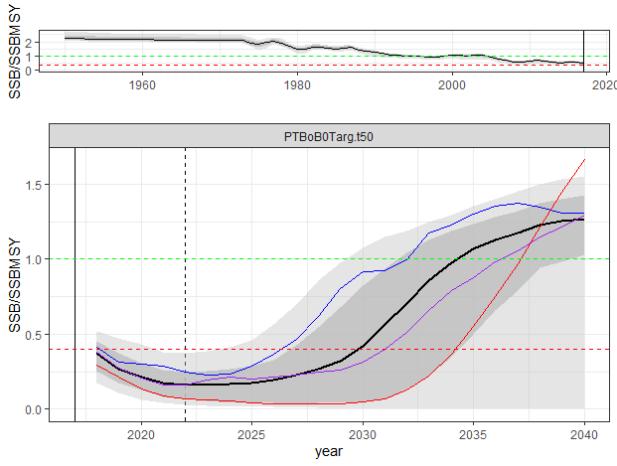
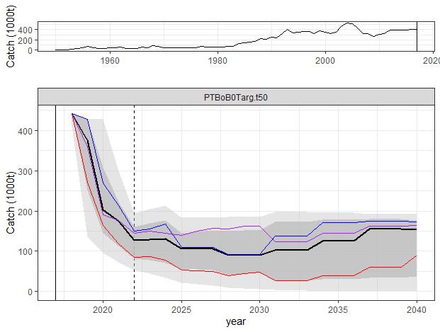
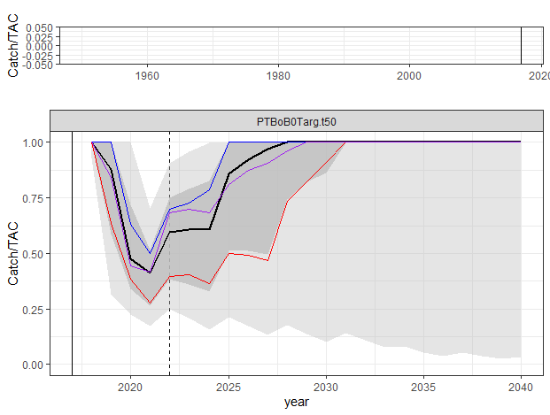
All Tuned MP results very pessimistic
Median rebuilding to BMSY by 2034
Requires ~ 75% drop in catch
B(t) / B(MSY)
[WA(H1]
Catch(t)
[WA(H1]It would be helpful to explain somewhere what the vertical dashed line in each of the major panels represents. I assume it is the start of MP implementation, but the decline in catches in the preceding few years suggests the TAC was implemented before this time.

Slide 14
Role of diagnostics in OMs?
Fit to CPUE – consistently better than we would have reason to expect, e.g. annualized aggregate RMSE < 0.17
Fit to size data – mixed, but fairly consistent among models (at least in terms of post-fit effective sample size)
Trends in recruitment deviations not substantial
All form a continuum mostly without obvious outliers

Slide 15
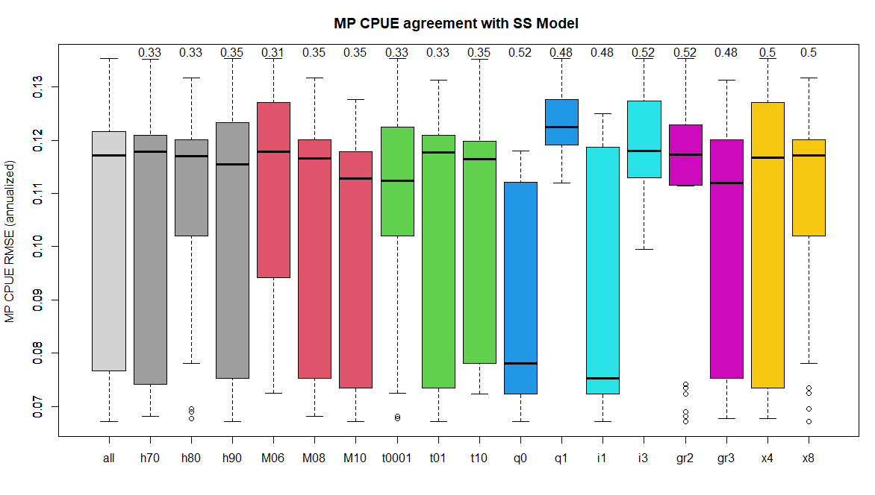
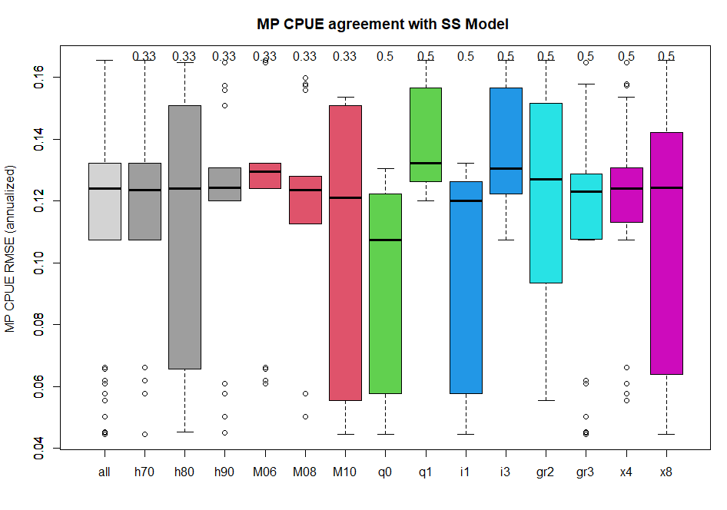
4 Areas (OMgridY21.1) CPUE RMSE 0.07 < RMSE < 0.14
2 Areas (OMgridY21.2) CPUE RMSE 0.04 < RMSE < 0.17

Slide 16
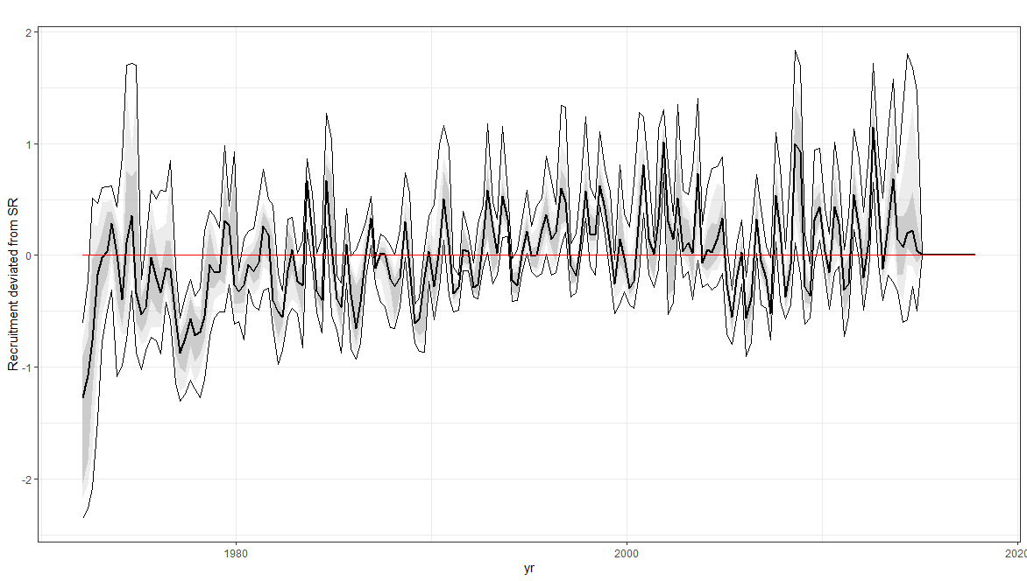
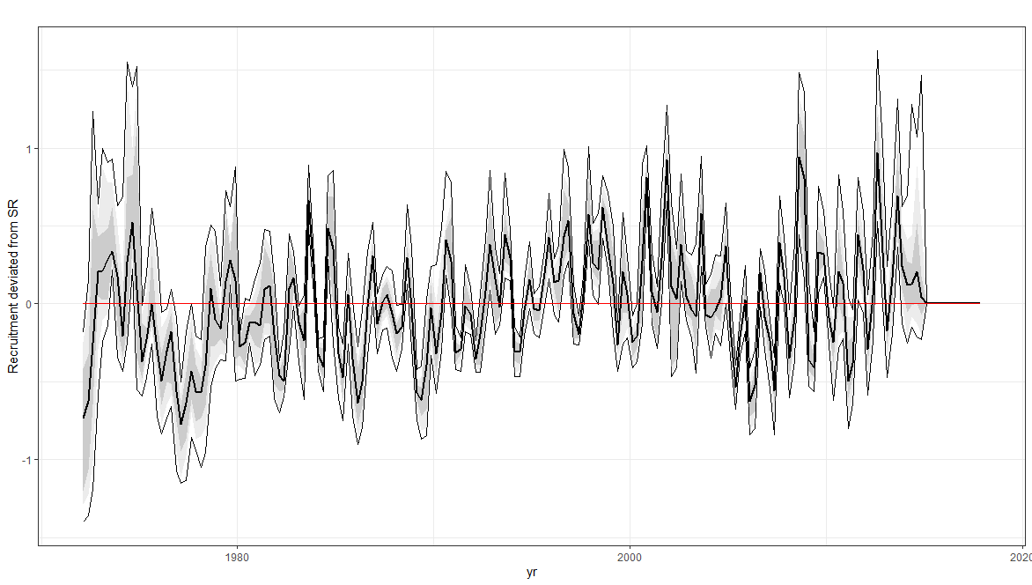
4 Areas (OMgridY21.1) Recruitment deviate series
2 Areas (OMgridY21.2) Recruitment deviate series

Slide 17
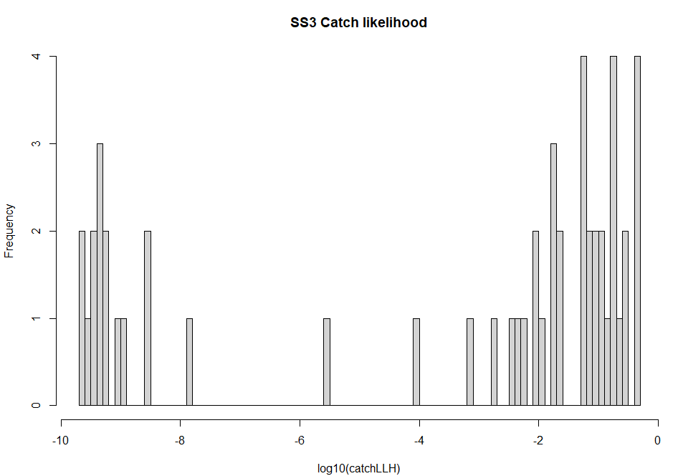
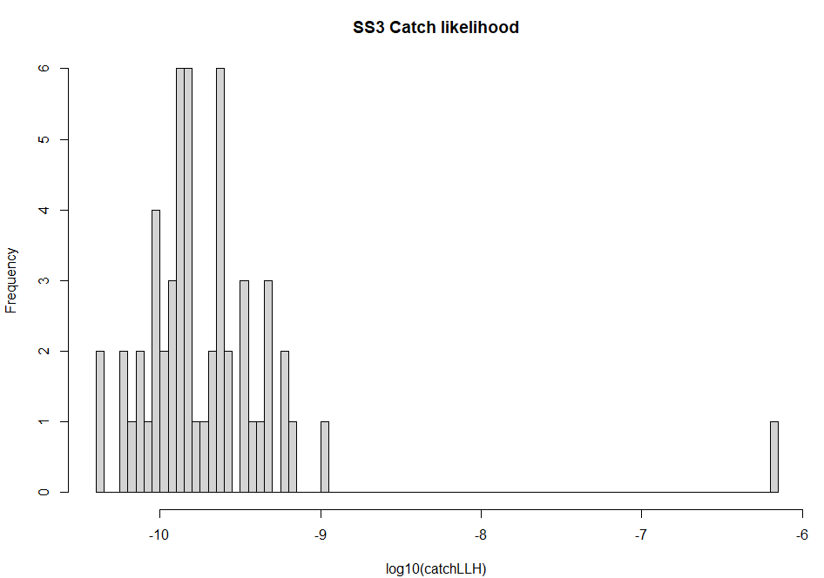
Very high F in some age/region strata
4 Areas
F < 2.9
H < 0.95
F > 2.9
H > 0.95
2 Areas
Probably indicates something is not realistic in the model
Should an implausibility threshold be adopted for rejection ?
Ignorable artefact of poor seasonal dynamics?

Slide 18
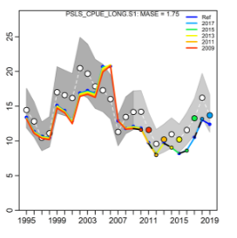
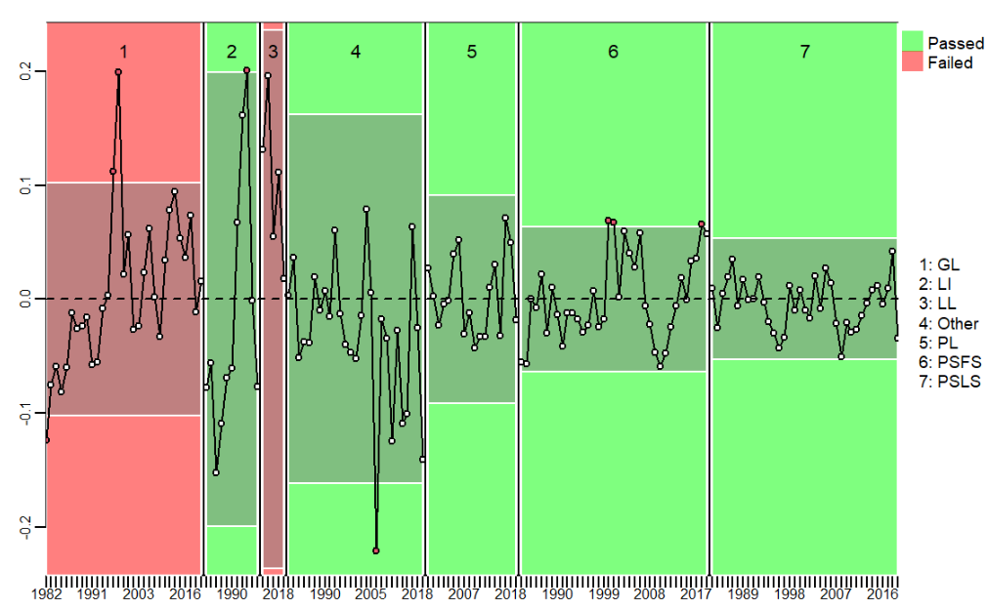
Role of diagnostics in OMs?
Runs test
Retrospectives
Hindcast predictions
Evaluate internal model consistency
Aims to ensure internal consistency, but model might still be based on flawed data and assumptions.
How to fix problems:
Discard models that fail threshold criteria
Various structural changes & alternative biological assumptions?
Time series structure in likelihoods?

Slide 19
Revisiting an old issue
Catch(t) / TAC(t)
B(t) / B(MSY)
<1 = Fail to take TAC
[WA(H1]
Decided to ignore before, i.e. failure to reach TAC inevitable if it is too aggressive
Conditioned movement, etc. estimates the best we have
Catch(t)
[WA(H1]It would be helpful to explain somewhere what the vertical dashed line in each of the major panels represents. I assume it is the start of MP implementation, but the decline in catches in the preceding few years suggests the TAC was implemented before this time.

Slide 20
Revisiting an old issue: a new diagnostic 1 Catch?
Conditioning data ends here
(2017)
MP starts here
[WA(H1]
<1 = Fail to take TAC
Catch(t) / TAC(t)
Observed 2019 catches cannot be removed by most OMs
Assumed catches for 2021, =C(2019), cannot be removed by any OM model
[WA(H1]It would be helpful to explain somewhere what the vertical dashed line in each of the major panels represents. I assume it is the start of MP implementation, but the decline in catches in the preceding few years suggests the TAC was implemented before this time.

Slide 21
Revisiting an old issue: a new diagnostic 2 Effort?
Conditioning data ends here
(2017)
MP starts here
[WA(H1]
<1 = Fail to take TAC
Catch(t) / TAC(t)
The OM assumes that Effective Effort can increase 20 X relative to 2016-2017 level, i.e. F(fishery, season, area)
Doesn’t seem realistic…
[WA(H1]It would be helpful to explain somewhere what the vertical dashed line in each of the major panels represents. I assume it is the start of MP implementation, but the decline in catches in the preceding few years suggests the TAC was implemented before this time.

Slide 22
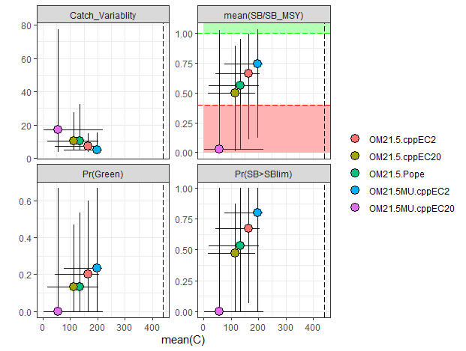
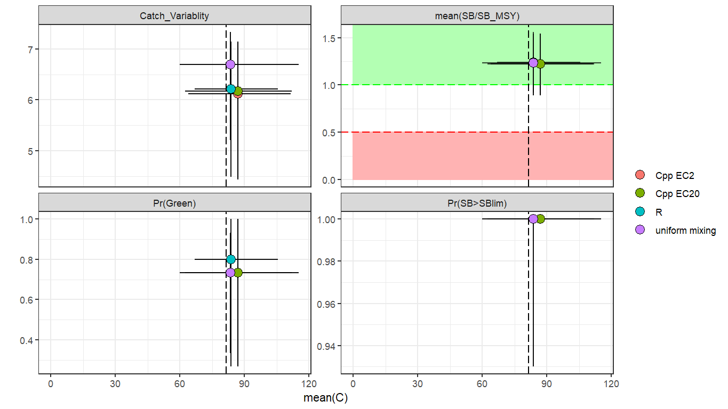
Are YFT MP evaluations sensitive to assumptions about catch extraction?
Same conditioning for all OMs, i.e. same initial state and production dynamics
Same MP
Effort Ceiling = 2 X 2017
Effort Ceiling = 20 X 2017
Pope’s approximation
Uniform Mixing, Eff Ceiling = 2
Uniform Mixing, Eff Ceiling = 20
Yes, unlike Bigeye

Slide 23
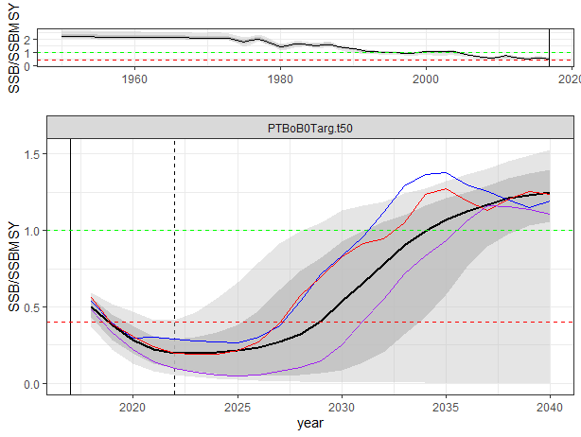
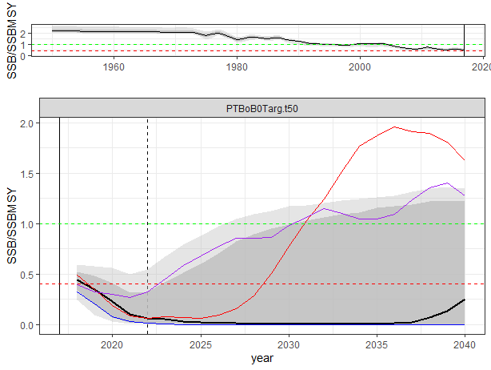
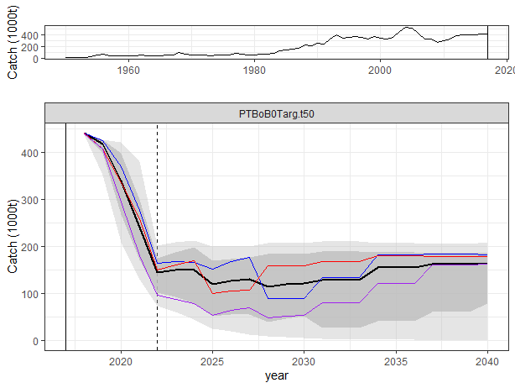
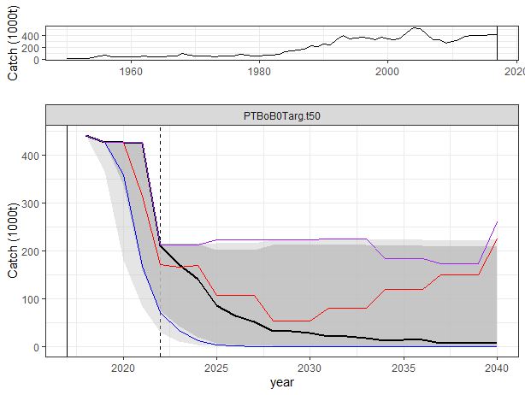
Extracting a bit more catch crosses a performance threshold
SS Movement + Effort Ceiling 20
Uniform Mixing + Effort Ceiling 20
B(t) / B(MSY)
B(t) / B(MSY)
Catch(t)
Catch(t)

Slide 24
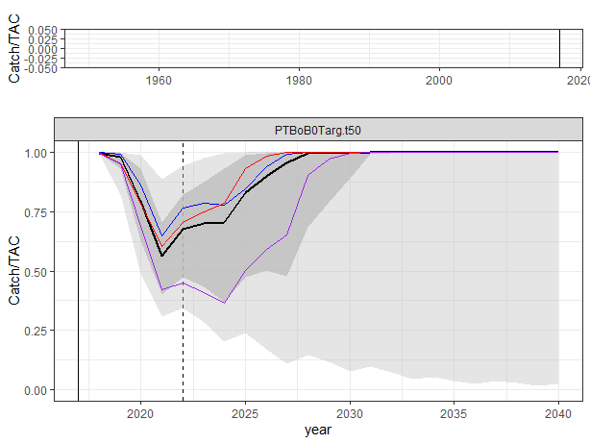
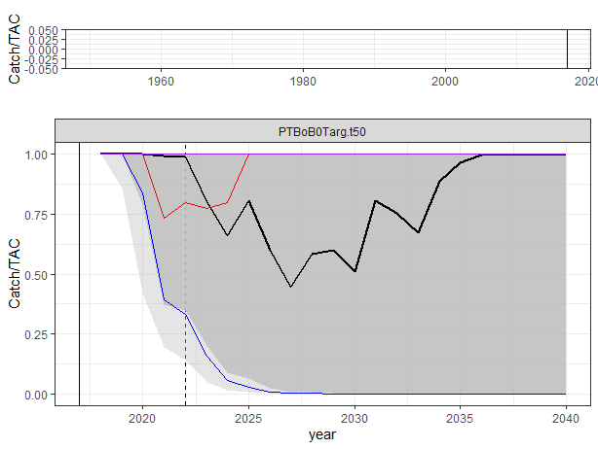
Extracting a bit more catch crosses a performance threshold
SS Movement + Effort Ceiling 20
Uniform Mixing + Effort Ceiling 20
C(t) / TAC(t)
C(t) / TAC(t)
Catch(t)
Catch(t)

Slide 25
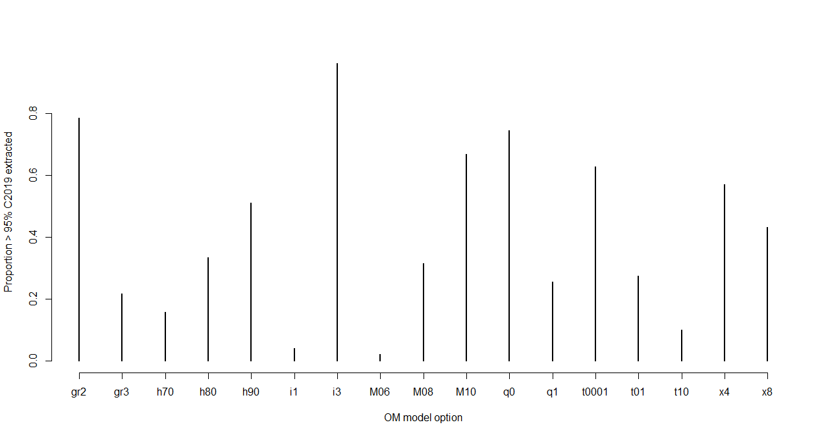
What if we use projection catch extraction and Effective Effort as a diagnostic filter?
Catch (OM extracted 2019) > 0.95 Catch (reported 2019)
Effort <= 2 X Effort (2017) for each fleet, (i.e. F)
Distribution of retained OM assumptions
4 Area reference set OM
90 % of realizations rejected
CPUE CV = 10%
Lowest M
Tags full weight

Slide 26
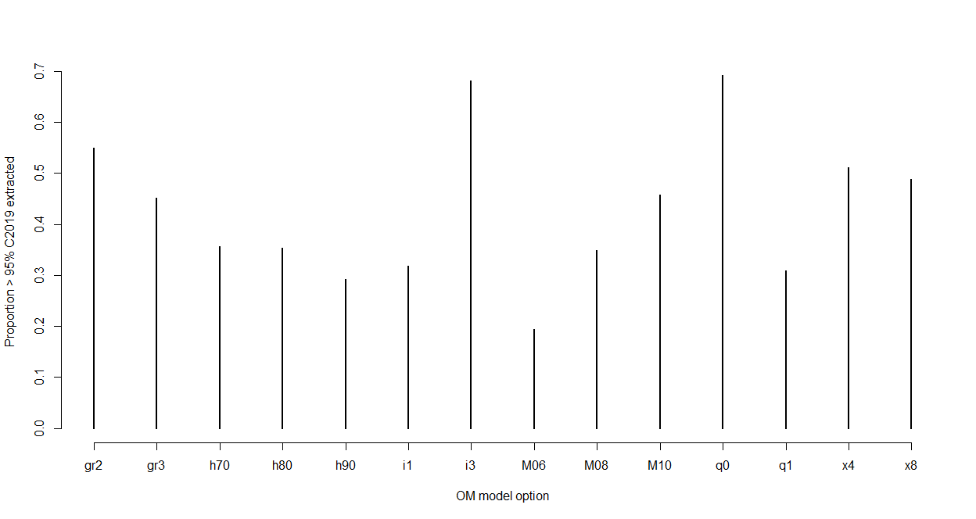
What if we use projection catch extraction and Effective Effort as a diagnostic filter?
Catch (OM extracted 2019) > 0.95 Catch (reported 2019)
Effort <= 2 X Effort (2017) for each fleet, (i.e. F)
2 Area reference set OM
41 % of realizations rejected
CPUE CV = 10%
Lowest M

Slide 27
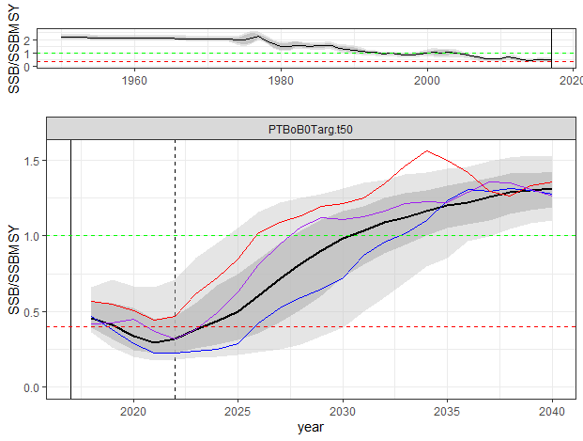
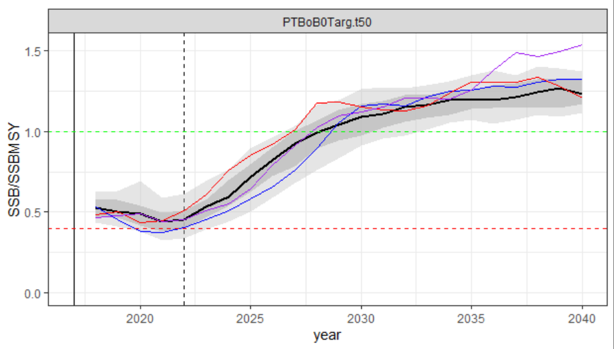
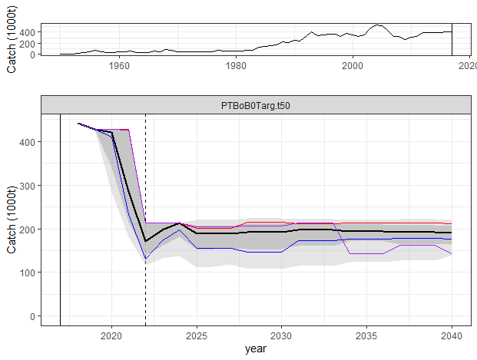
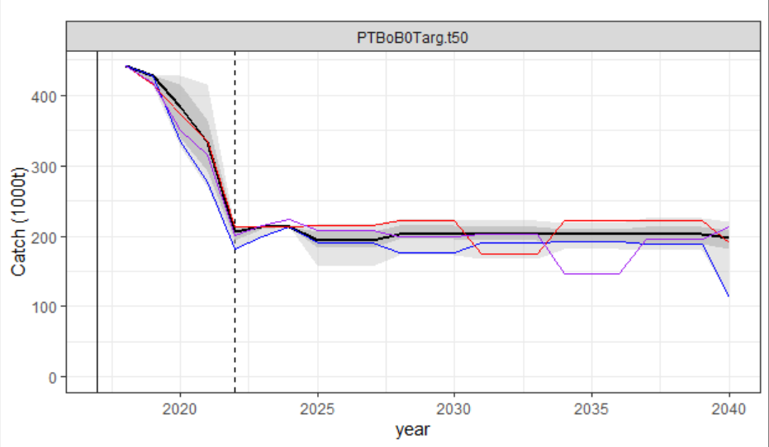
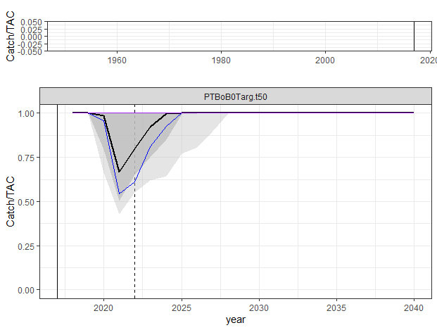
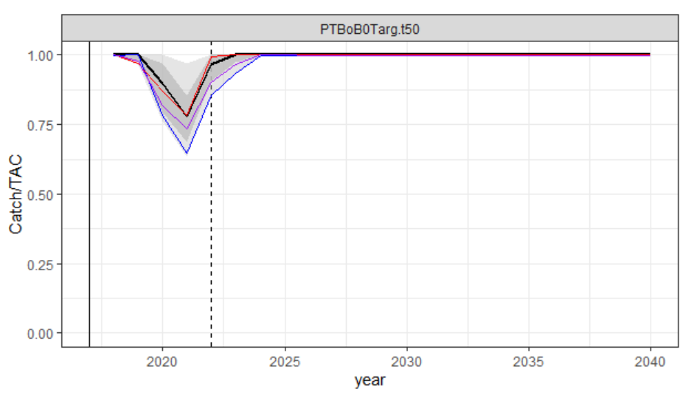
Does this filter really solve anything?
4 Area reference set OM
2 Area reference set OM
B(t) / B(MSY)
Rebuilding brought forward ~ 5 years
(4 area model actually more optimistic than 2 area)
Catch(t)
The filtering is applied to MSE realizations, hence positive
stochastic recruitment probably contributing to successes
C(t) / TAC(t)
99 % of realizations rejected if
2021 bridging catch also required
80 % of realizations rejected if
2021 bridging catch also required
4 Area reference set OM 2 Area reference set OM

Slide 28
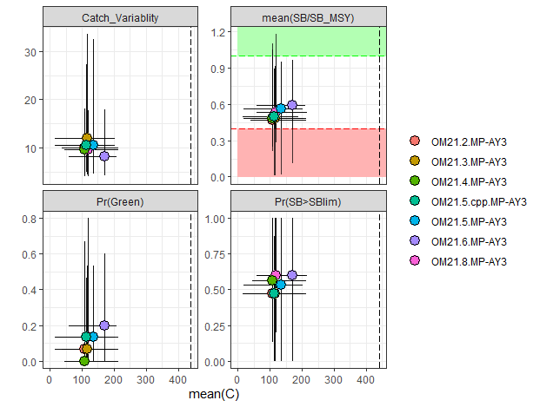
What do we expect the updated data to do?
2 Additional OMs reconditioned to include 2018-219 catch data*
Not much effect on OM
4 Area OM ensemble
90% of SS models fit invoked catch penalty
2 Area OM ensemble
63% of SS models fit invoked catch penalty
* Actually 2017 catch data repeated 2 times

Slide 29
Conclusions & Recommendations
Current Yellowfin OMs under consideration are very pessimistic, and not consistent with catch (and probably effort) observations since the 2017 conditioning data.
MP results should not be presented to TCMP until OMs can be improved, in conjunction with 2021 stock assessment efforts.
There is clearly a role for diagnostics that evaluate model plausibility, but it is not clear that the current OM (or stock assessment) ensemble is sufficiently broad to encompass the true state of the stock
There appears to be some fundamental incompatibility between the reported catches and relative abundance indices that persists across a wide range of structural assumptions.
Given the concerns above, we are reluctant to conclude that other results are robust, e.g.
Not clear whether 2 area or 4 area structure is better (or even which is more optimistic), though 4 area is more realistic for representing tags and heterogenous CPUE series).
MP results appear sensitive to nuisance assumptions about the choice of catch equations and movement representation (in contrast to bigeye)
We recommend that the next iteration of the OM/assessment should entertain some broader structural options.
We recommend that the IOTC should be seriously considering new data sources to help resolve these issues, notably Close-Kin Mark Recapture, and acoustic FAD based surveys.

Slide 30
Merci Thanks!
With thanks to the Australian Department of Foreign Affairs and Trade and FAO/IOTC for funding support, and the WPTT, WPM, TCMP and MSE Task Force for constructive engagement, and the legacy of countless clever modellers, statisticians, computer scientists and biologists upon which everything is built.

